Slide 1

SCTR’s Pune Institute of Computer Technology, Pune electronics and Telecommunication engineering
“SmartTrack –
Efficient Attendence Solutions”
Guide: Ms. P. B. Tathe
By:
1) Vedant Narawadkar (32151)
2) Nikhil Mahamuni (32152)
3) Saurav Kumar (32165)

Slide 2
Introduction
Motivation:
Addressing Manual Attendance Challenges
Traditional attendance systems are time-consuming and prone to human errors, such as missed entries or duplicates.
Streamlining the Process
Automating attendance tracking saves time for teachers and students.
A quick and seamless solution eliminates the need for roll calls or paper-based records.
RFID Technology: Cost-Effective and Reliable
RFID modules and cards are affordable, durable, and easy to use, making them an ideal choice for educational institutions.
They provide a faster and contactless way to log attendance compared to biometric systems.
Real-Time Data Access and Storage
Leveraging Firebase ensures secure and real-time data storage, making attendance records accessible from anywhere.
Reducing Administrative Overhead
Simplifies record-keeping and minimizes the workload of faculty and administration.
Environmental and Operational Benefits
Reduces paper usage, contributing to eco-friendly practices.
Improves operational efficiency and reduces delays caused by traditional systems.

Slide 3
Objectives
Automate Attendance Tracking
Develop a system that uses RFID technology to automatically record student attendance in a fast and efficient manner.
Ensure Real-Time Data Logging
Implement real-time data storage and retrieval using Firebase for accurate and up-to-date attendance records.
Eliminate Manual Errors
Minimize human errors associated with traditional attendance methods such as roll calls or paper registers.
Optimize Cost and Scalability
Utilize cost-effective RFID modules and cards, making the system feasible for large-scale implementation in educational institutions.
The primary problem to be tackled is the inefficiency, inaccuracy, and time-consuming nature of manual attendance recording, which is prone to errors such as proxy attendance and lost records.
15-4-25

Slide 4
Literature survey
“RFID Based Attendance System” [1] Authors: Not specified Published in: ResearchGate, 2019 Summary: This paper discusses the implementation of an RFID-based attendance system aimed at enhancing efficiency and accuracy in attendance management. The system utilizes RFID technology to automate the process, reducing manual errors and saving time.
“Using RFID Technology to Track Attendance” [2] Authors: Not specified Published in: Journal of Financial Education, 2012 Summary: This study explores the application of RFID technology in tracking attendance, highlighting its reliability and unbiased data collection, including precise timestamps for arrivals and departures. The paper emphasizes the cost-effectiveness and efficiency of RFID systems in educational settings.
“IoT Based Smart Attendance System Using RFID: A Literature Review” [3]
Authors: Kashif Ishaq, Samra Bibi Published in: arXiv, 2023 Summary: This systematic literature review examines 21 significant studies on IoT-based attendance systems employing RFID technology. The paper highlights the advantages of automating attendance processes, addressing issues associated with manual methods, and providing insights for institutions aiming to develop advanced attendance systems.

Slide 5
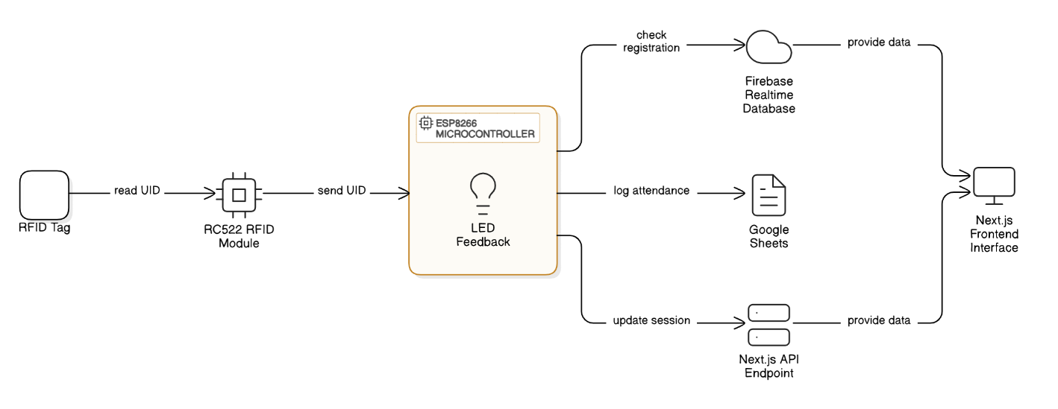
Block Diagram /working model
15-4-25

Slide 6
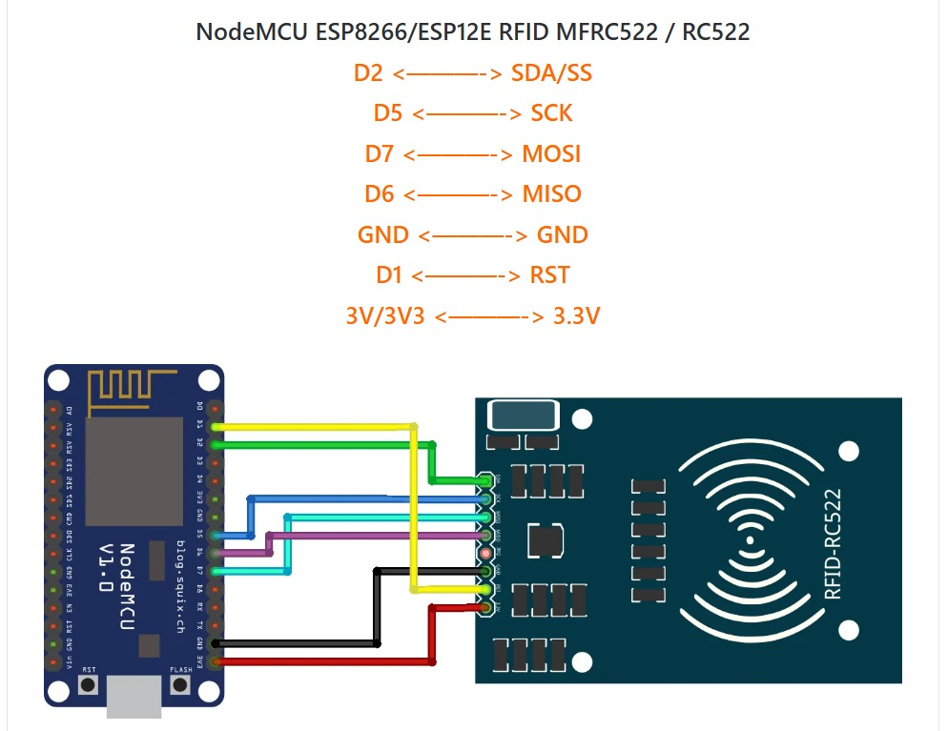
Circuit Diagram
15-4-25

Slide 7
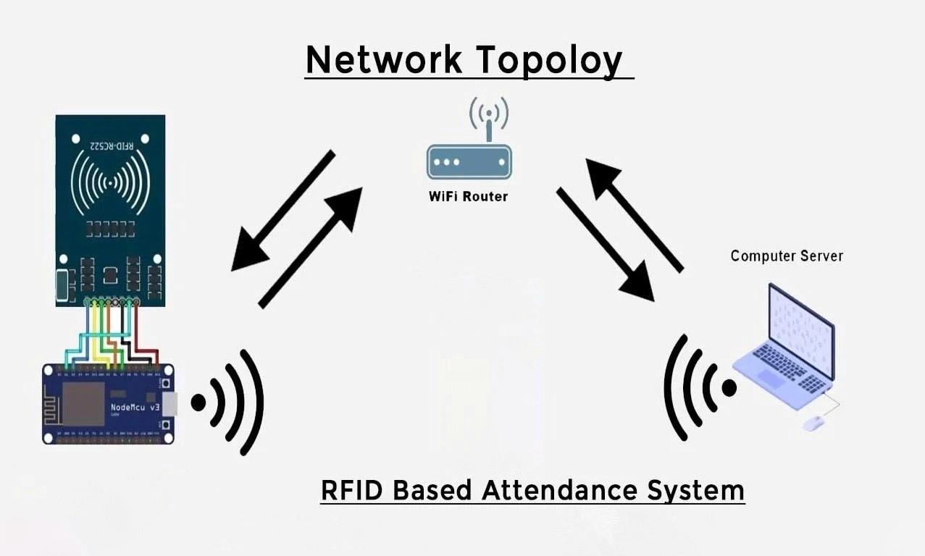
Network topology
15-4-25

Slide 8
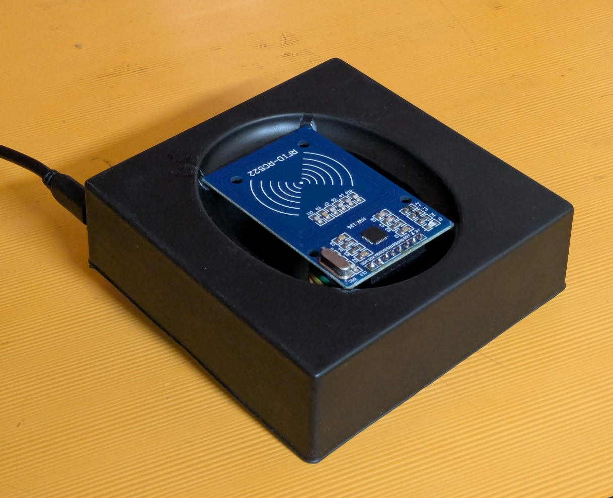
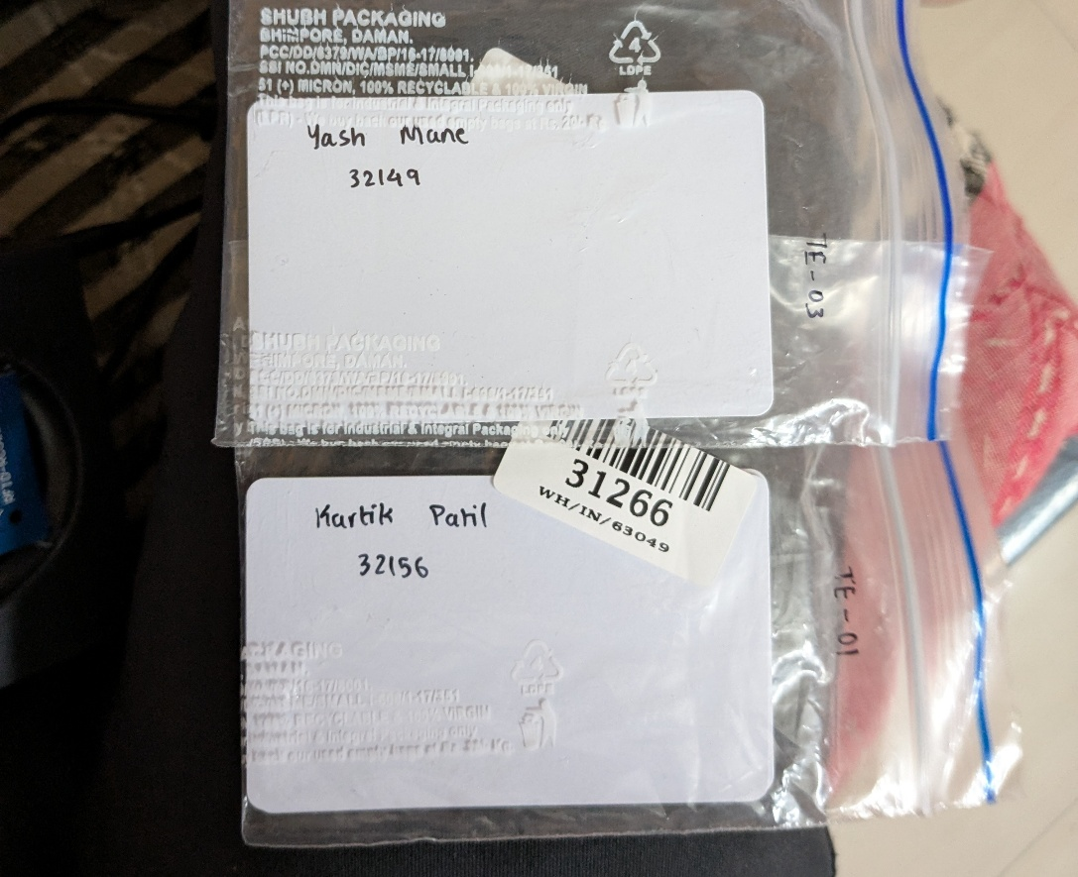
Project photos
15-4-25

Slide 9

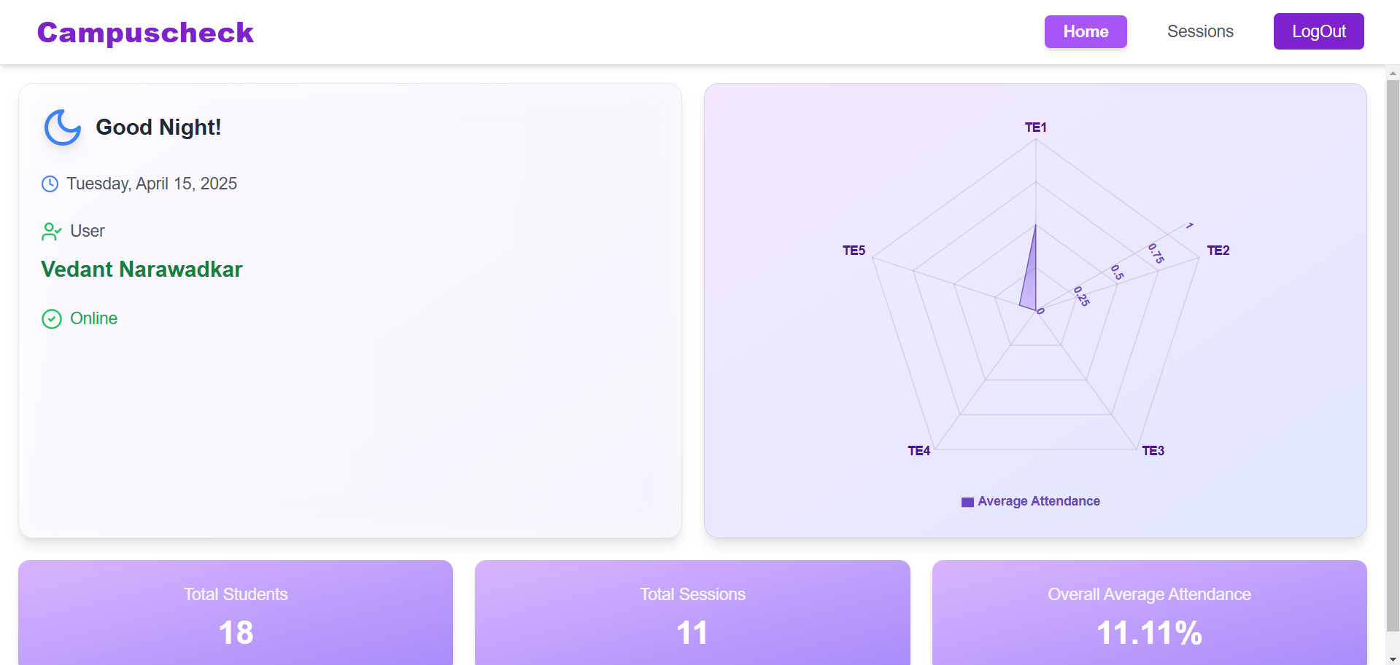
Project photos
15-4-25

Slide 10
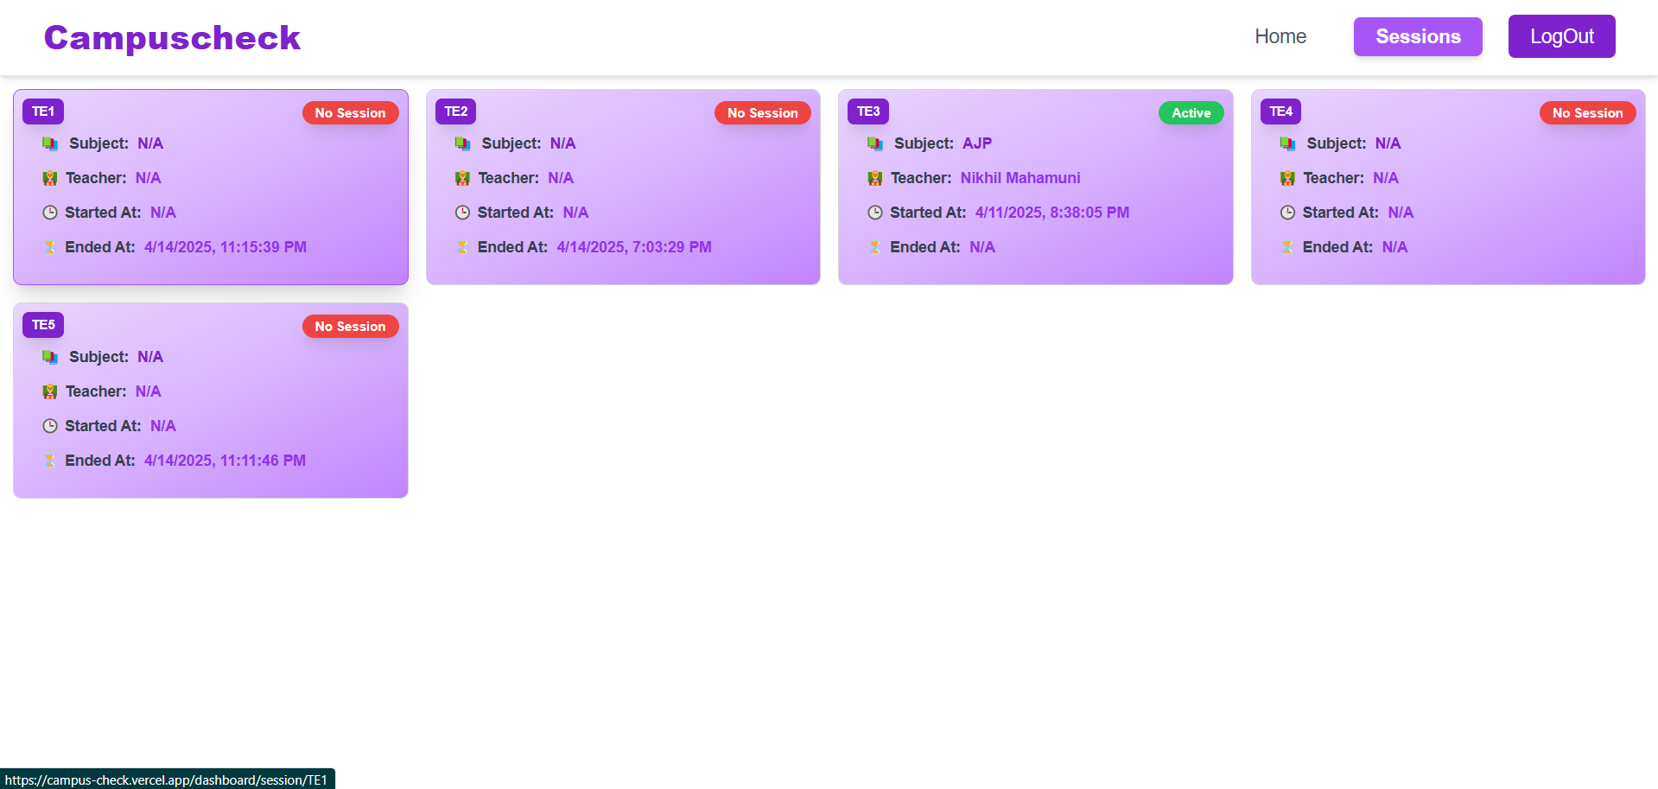

Project photos
15-4-25

Slide 11
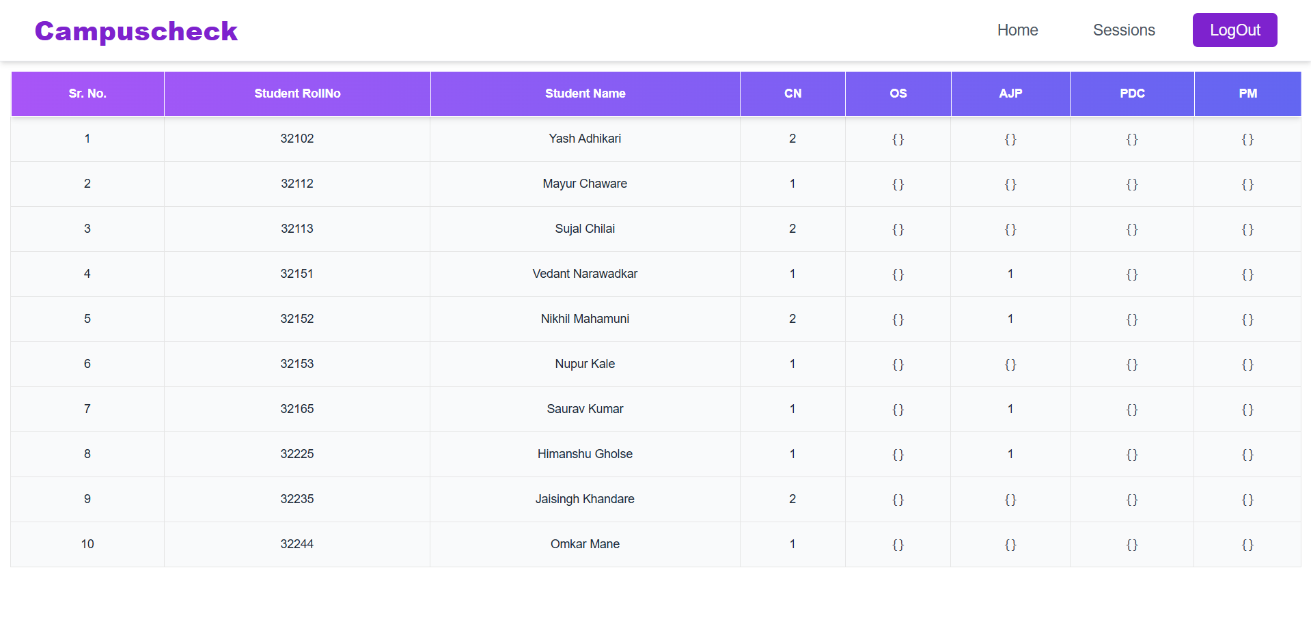
Project photos
15-4-25

Slide 12
Resources Required
Hardware:
RFID Module:
RC522 is a popular, low-cost RFID module.
It comes with an RFID reader and supports 13.56 MHz RFID cards.
RFID Cards:
Each student (4 total) will have an RFID card (cheap and reusable).
Microcontroller:
ESP32 (preferred due to built-in Wi-Fi and Bluetooth).
Power Supply:
USB power or a 5V adapter for the ESP32.
Cables and Connectors:
Jumper wires for connections.

Slide 13
Resources Required
Softwares with Versions:
Arduino IDE (Version 1.8.19 or newer)
Used for programming ESP32 microcontroller to interface with RFID module.
ESP32 Board Manager (Latest Version)
Installed in the Arduino IDE to enable programming and uploading code.
Firebase Realtime Database:
For storing and managing attendance data.
Next.js (Version 13 or newer)
Framework for creating the web application to display attendance records.
Visual Studio Code (Version 1.80 or newer)
Code editor for developing ESP32 sketches and the web interface.
Firebase CLI (Version 12 or newer)
For deploying the Next.js application to Firebase Hosting.
Browser (Latest Version)
Google Chrome or Mozilla Firefox for testing the web application.

Slide 14
References
[1] Title: “RFID Based Attendance System”, Publication: ResearchGate, Year: 2019 https://www.researchgate.net/publication/235598499_RFIDBased_Students_Attendance_Management_System
[2] Title: “Using RFID Technology to Track Attendance”, Publication: Journal of Financial Education, Year: 2012 https://libjournals.mtsu.edu/index.php/jfee/article/download/1490/1069/4101
[3] Authors: Kashif Ishaq, Samra Bibi, Title: “IoT Based Smart Attendance System Using RFID: A Systematic Literature Review”, Publication: arXiv, Year: 2023 https://arxiv.org/abs/2308.02591
[4] Book: Authors: Shibu K. V., Title: "Introduction to Embedded Systems", Edition: 1st Edition, Year: 2019, Publisher: Tata McGraw-Hill, Page No.: 204-209.
[5] Title: “How RFID Works in Attendance Systems”, Year: 2021, Summary: This page explains the working mechanism of RFID-based attendance systems and how they can be used for real-time student attendance tracking.
https://www.tescaglobal.com/
15-4-25

Slide 15
Thank You!
15-4-25

